Slide 1
a WORKSHOP on Table manners for children
Manners n beyond
The Best Memories are made Around The Table
Notes:
The best memories are made around the table

Slide 2
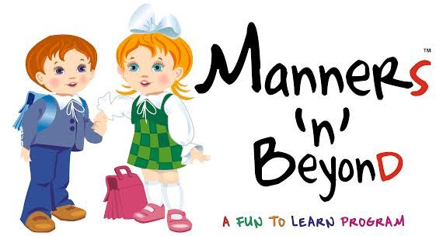
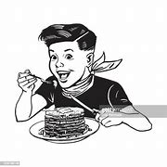
Why should children learn table manners?
When children learn to eat with good manners, they are less likely to offend, and more likely to impress, when they find themselves in pivotal social situations later on.

Slide 3
What will children learn?
Tools of the trade
Setting the table
Napkin etiquette- Silence Service Code rule
Bread / Butter and condiments rule
Some table rules
Soup rule
Eating rice/noodles and spaghetti
Eating Salad/ Desert the right way
Drinking tea/coffee the right way
The finger bowl rule
Restaurant etiquette
Answering an invitation
Do’s and don’ts of table manners

Slide 4
How will children learn?
Live sessions through Zoom or MS Team
Game
Role playing exercises

Slide 5
Assessment strategies
Open ended questions
Self reflection activities
Quizzes
Worksheets

Slide 6
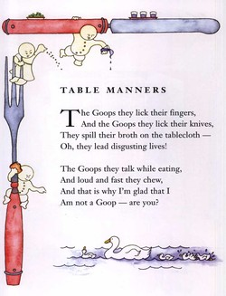
How will WE RUN IT?
In several batches, of 25 students each, in the age group of 3 to 7 and 8 to 12 years.
Duration of each batch will be approximately1 hour and 30 minutes.

Slide 7
What will children achieve?
Children will have a hands-on learning experience with a 4- course meal from the Manners N Beyond table etiquette series, which will help them to work on their manners and proper eating etiquette.

Slide 8
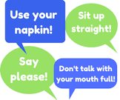
Course fee
The course is priced at INR 20,000/- for each batch of 20 to 25 students in each age group

Slide 9
THANK YOU
“The way you treat your food on your plate is a reflection of the way you treat people in your life. Learning how to dine teaches you not just how to eat but how to treat people”
Notes:
The way you treat your food on your plate is a reflection of the way you treat people in your life. Learning how to dine teaches you not just how to eat but how to treat people

